Slide 1
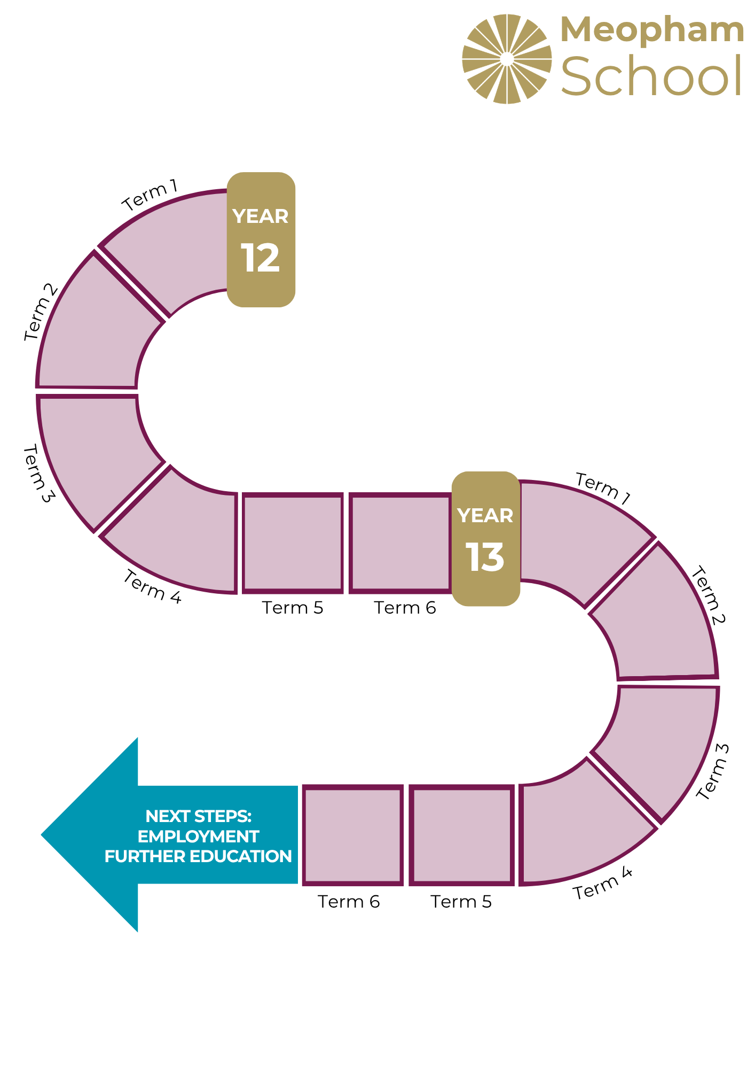
Media
Department Curriculum
MEDIA 1
ADVERTISING, MUSIC VIDEOS
MEDIA 1
RADIO, FILM
MEDIA 1
NEWSPAPERS, KEY THEORIES, NEA PREPARATION
MEDIA 2
MAGAZINES, TELEVISION,
NEA
MEDIA 2
MAGAZINES, TELEVISION,
NEA
MEDIA 1 REVISION,
NEA
MEDIA 2
GAMING,
SOCIAL MEDIA
MEDIA LANGUAGE, MEDIA REPRESENTATION
MEDIA AUDIENCE, MEDIA INDUSTRIES
REVISION
FINAL EXAM
MEDIA 2
REVISION , NEA
MEDIA 1 REVISION , NEA

